Slide 1
Deriving Instantaneous Electro-Thermal Parameters and Heat Generation from Constant-Current Discharge Data
Nicholas A. Ingarra, PhD, P.E. ¹,
Krzysztof (Chris) J. Kobus, PhD², Jadon G. Kobus²

Slide 2
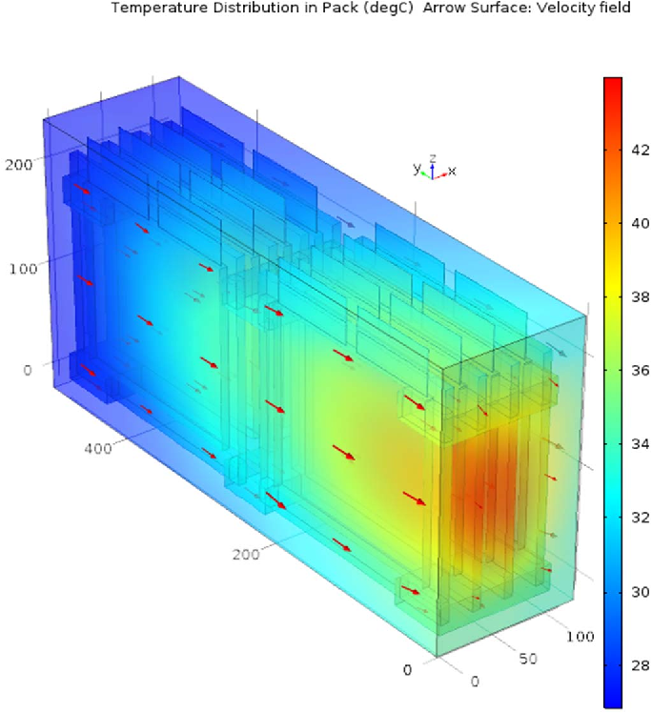
| Executive Summary
Problem:
Early-stage Battery Thermal Management System (BTMS) design relies on steady-state thermal assumptions due to limited manufacturer data.
If heat generation is inaccurately modeled, an AC compressor may lack capacity or the cold plate will be improperly sized, risking thermal runaway or excess weight.
Solution:
Derive real-time cell resistance, instantaneous efficiency, and time-dependent directly from the standard issued discharge curves & Open Circuit Voltage (OCV) profiles.
2

Slide 3
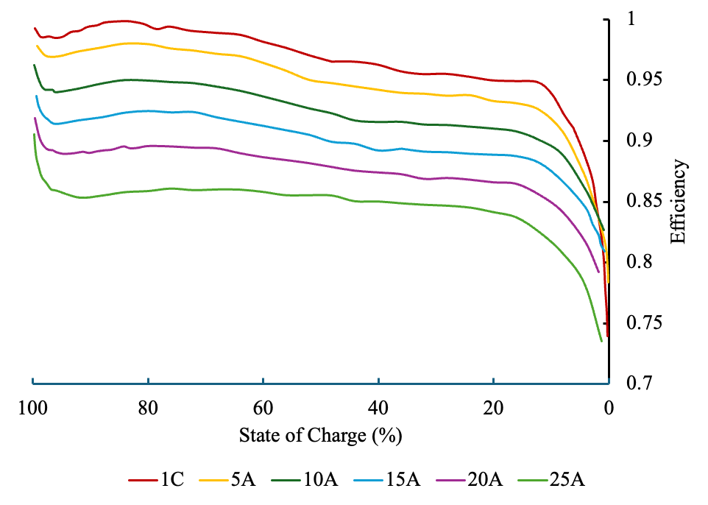
| Technical Summary
Time-dependent, instantaneous cell efficiency is introduced to replace static Coulombic & Voltaic averages.
Equivalent resistance inherently contains all transient losses: activation, Ohmic, and concentration.
By bypassing steady-state Joule heating, this approach is direct, real time coupling of electrical & thermal system models
3

Slide 4
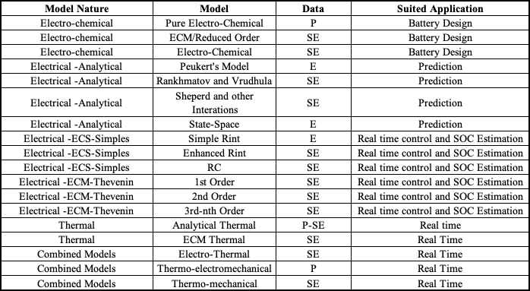
| Types of Battery Models
4
Notes:
There is not a single battery model that does everything

Slide 5
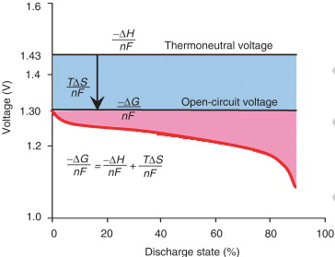
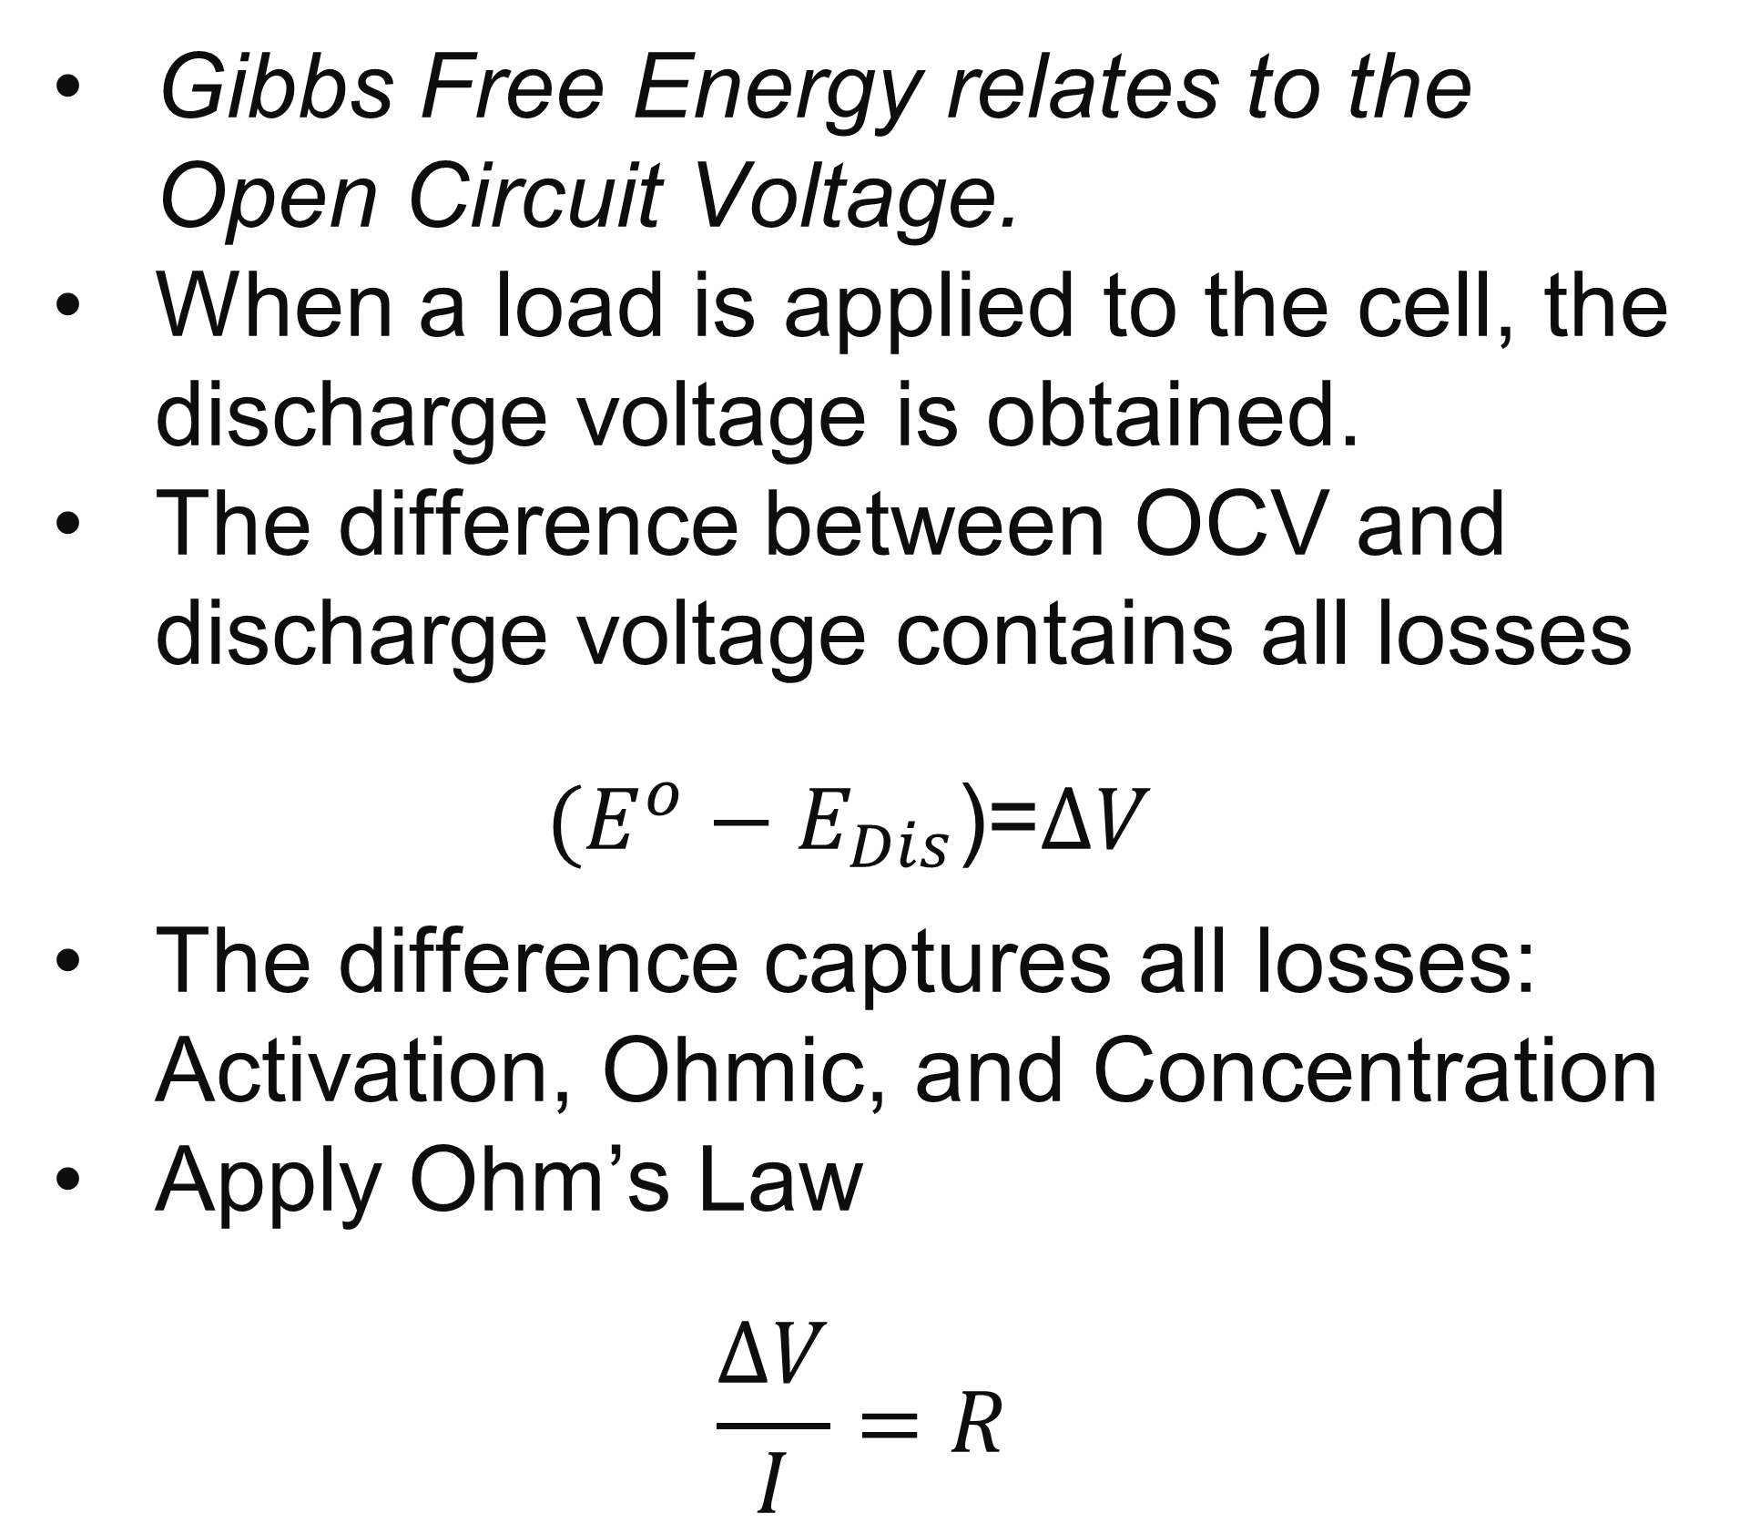
| Procedure: OCV vs. Discharge Voltage
Gibbs Free Energy relates to the Open Circuit Voltage.
When a load is applied to the cell, the discharge voltage is obtained.
The difference between OCV and discharge voltage contains all losses
  $(E^{o}−E_{Dis}$)=$∆V$
  The difference captures all losses: Activation, Ohmic, and Concentration
Apply Ohm’s Law
$$\frac{∆V}{I}=R$$
Theoretical Voltage vs. Discharge Voltage
5

Slide 6
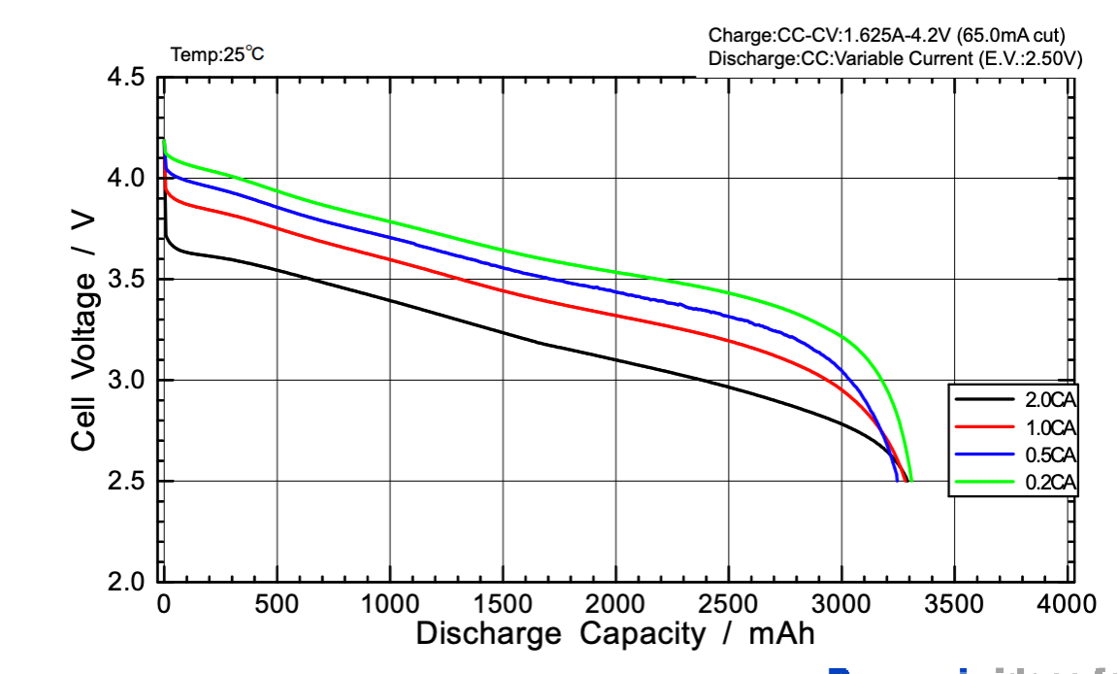
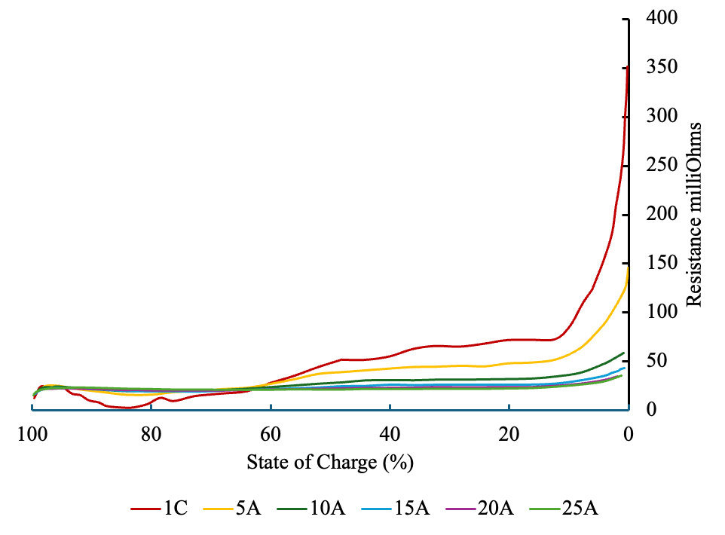
| Sample Resistance Obtained
Sample Discharge Curve
General Cell Resistance
Stable Operating Window
The overall cell resistance is changing with state of charge and C-rate
Overall Resistance contains all losses (losses can be broken down)
Below 20% SOC, concentration losses dominate
6

Slide 7
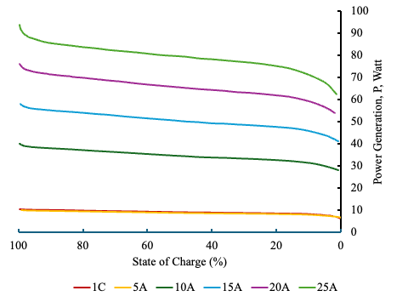
| Cell Power Delivery
Cell Power Delivery
The discharge power is decreasing due to resistance increasing.
E.g., resistance, the power drops off when the SOC is less than 20%
There is “stable” power region between 80% to 20% SOC (represented in green)
The lost power is the form of heat generation
7

Slide 8
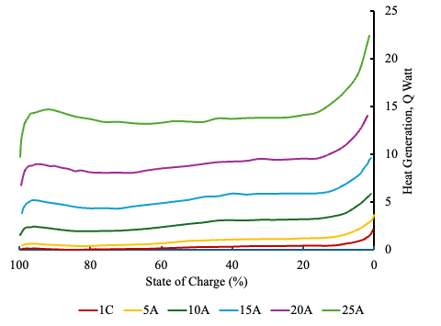
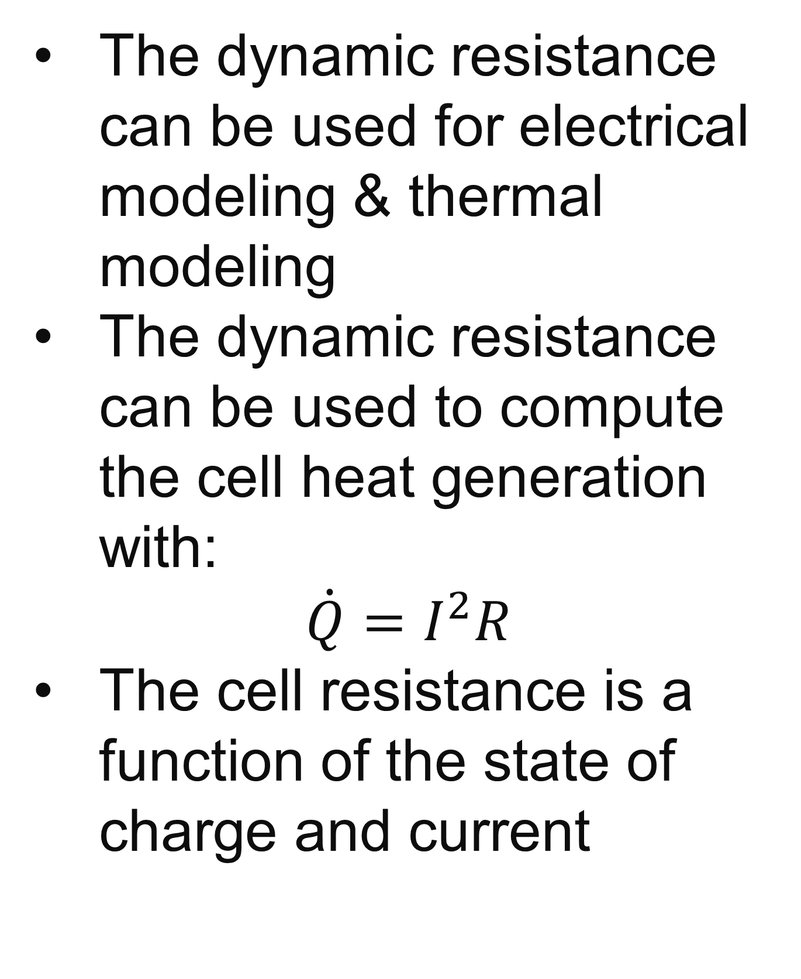
| Heat Generation of the Cell
Cell Heat Generation
The dynamic resistance can be used for electrical modeling & thermal modeling
The dynamic resistance can be used to compute the cell heat generation with:
    $$\dot{Q}=I^{2}R$$
The cell resistance is a function of the state of charge and current
Stable Operating Window
8

Slide 9
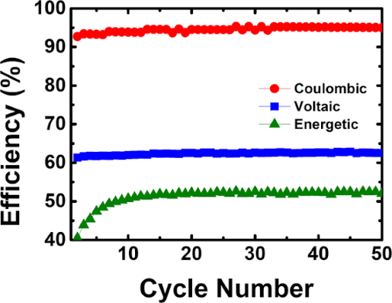
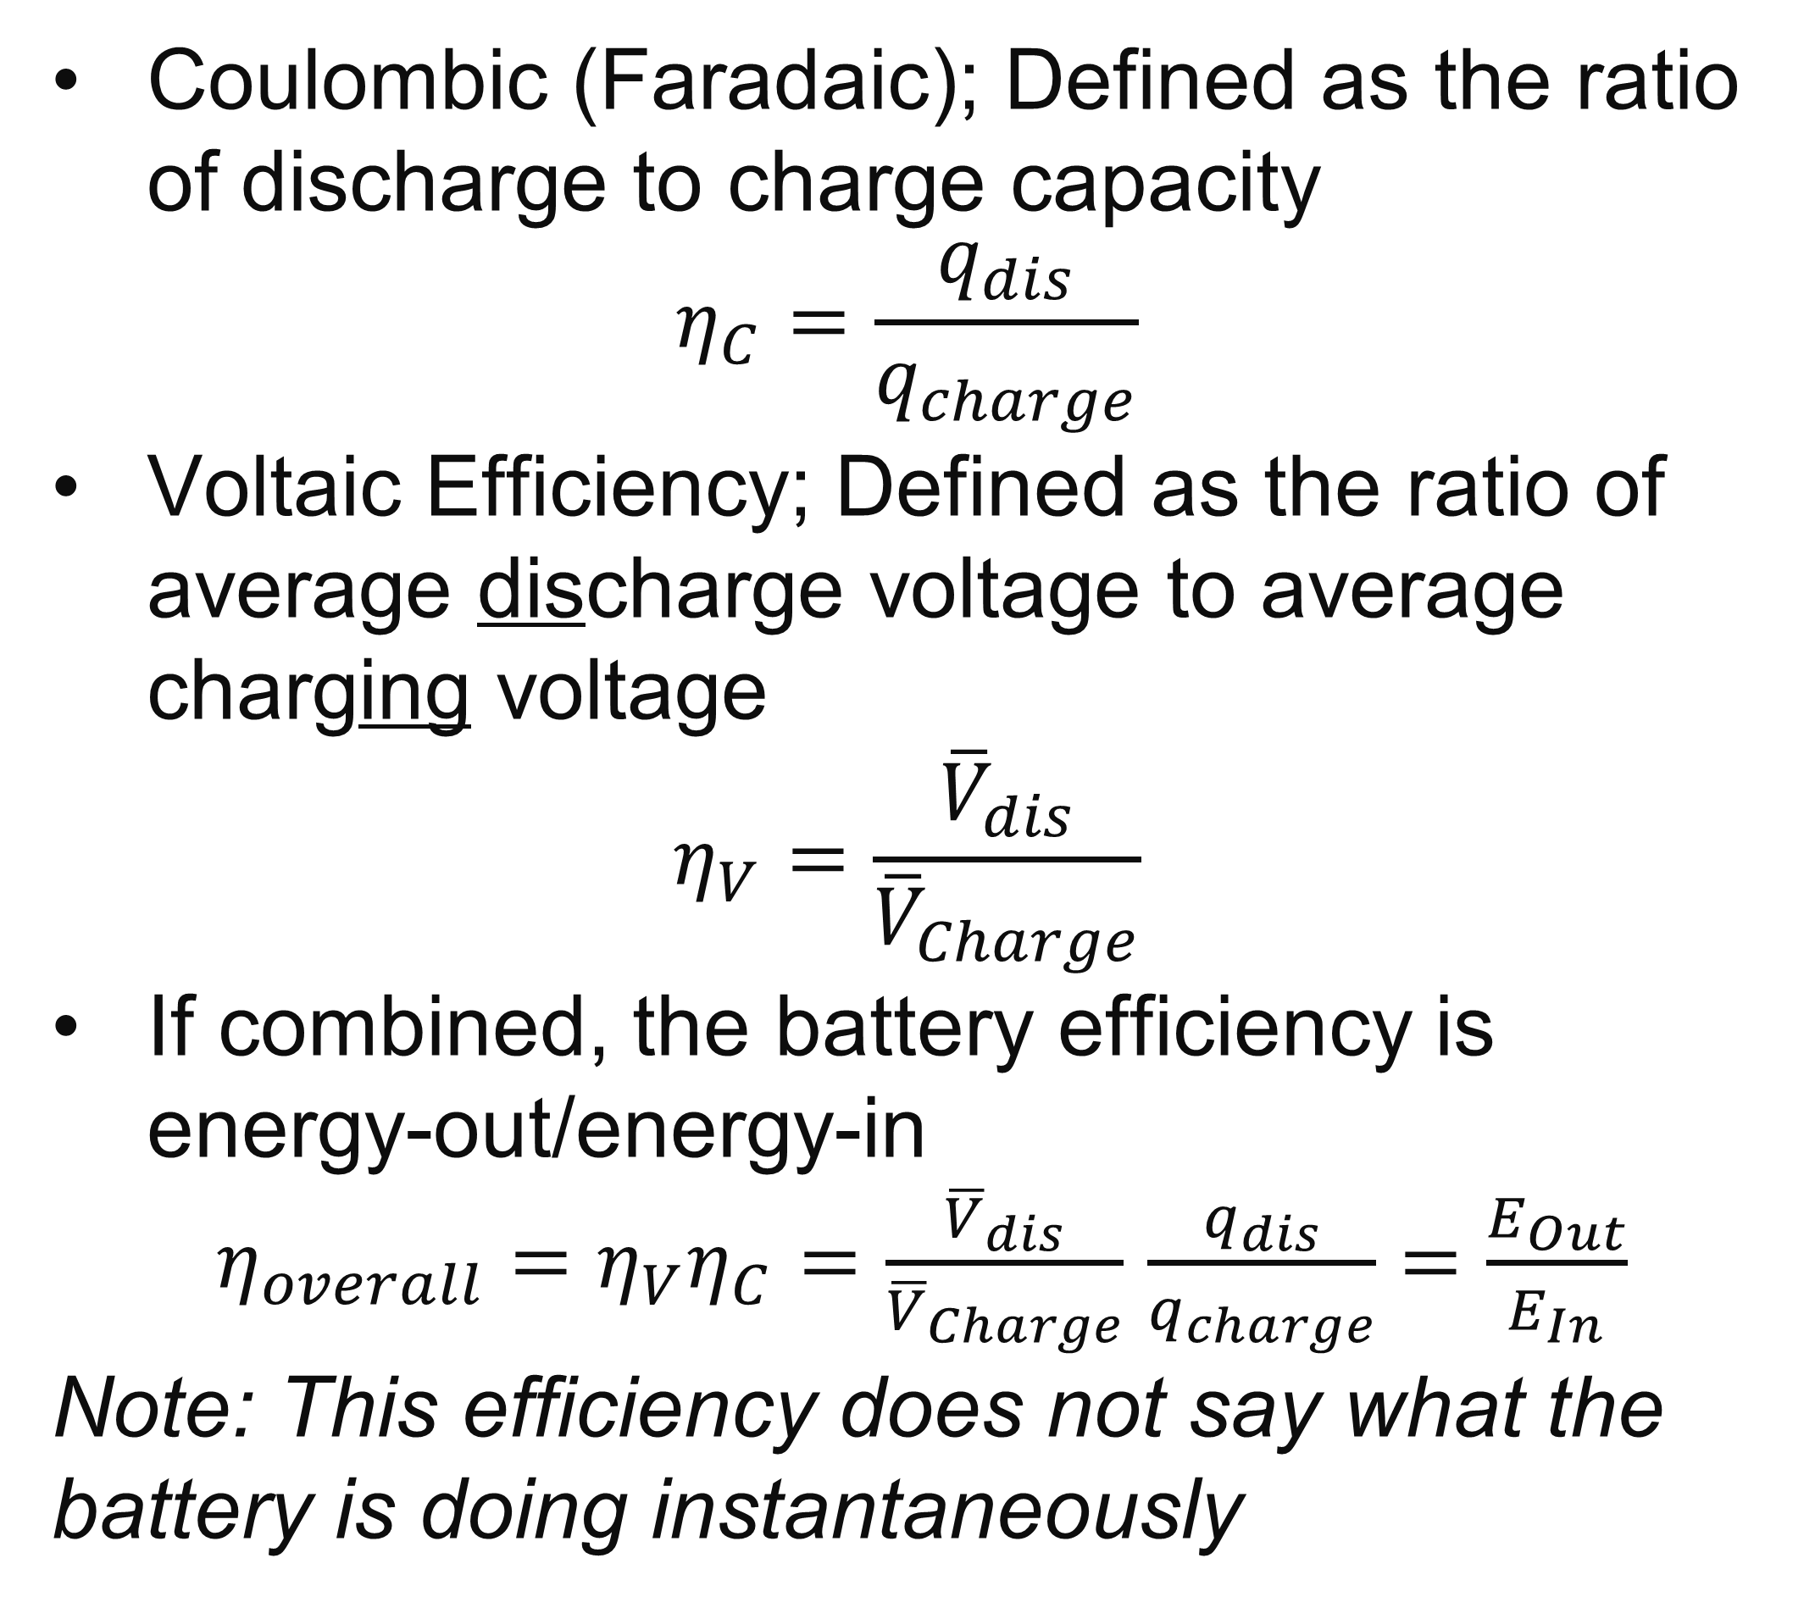
| Current Cell Efficiency
Coulombic (Faradaic); Defined as the ratio of discharge to charge capacity
    $$η_{C}=\frac{q_{dis}}{q_{charge}}$$
Voltaic Efficiency; Defined as the ratio of average discharge voltage to average charging voltage
    $$η_{V}=\frac{{\overline{V}}_{dis}}{{\overline{V}}_{Charge}}$$
If combined, the battery efficiency is energy-out/energy-in
  $η_{overall}=$ $η_{V}η_{C}=\frac{{\overline{V}}_{dis}}{{\overline{V}}_{Charge}}$ $\frac{q_{dis}}{q_{charge}}=\frac{E_{Out}}{E_{In}}$
  Note: This efficiency does not say what the battery is doing instantaneously
9

Slide 10
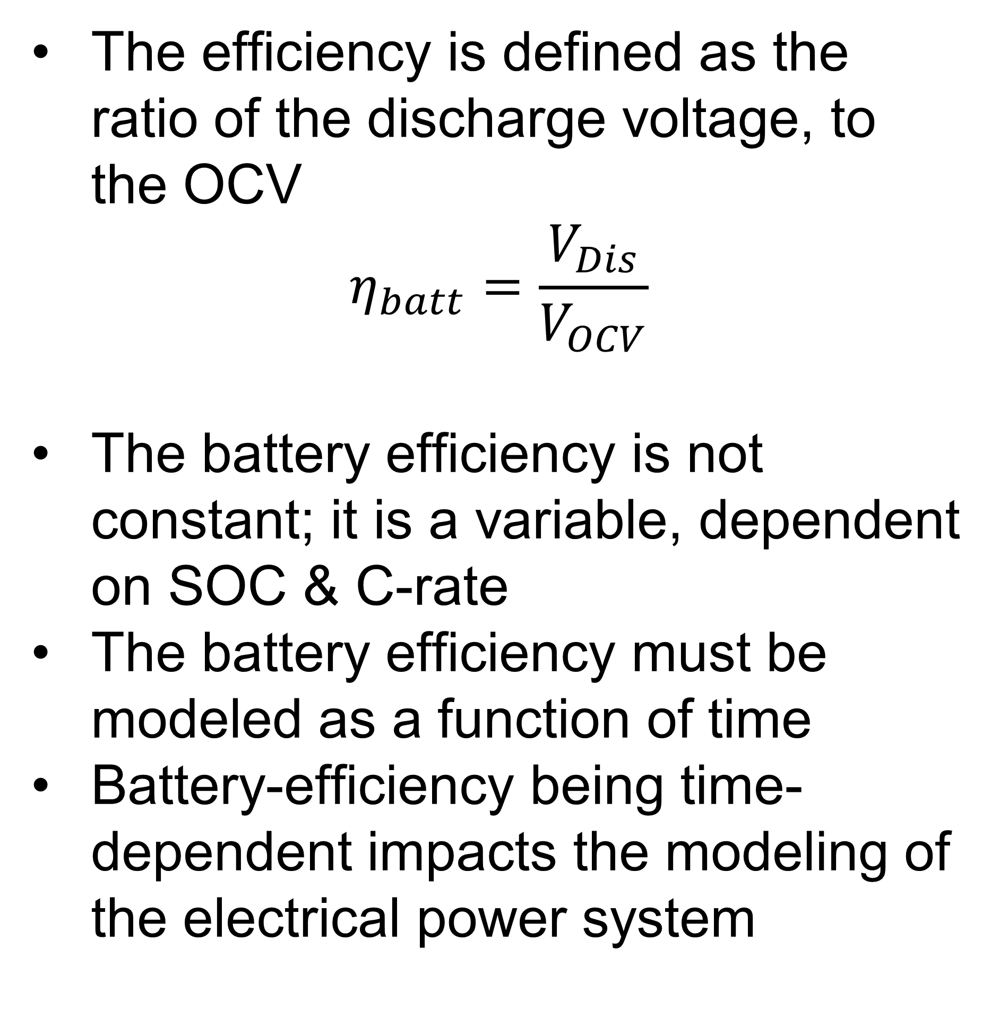
| Redefined Efficiency
Cell Efficiency
The efficiency is defined as the ratio of the discharge voltage, to the OCV
$$η_{batt}=\frac{V_{Dis}}{V_{OCV}}$$
The battery efficiency is not constant; it is a variable, dependent on SOC & C-rate
The battery efficiency must be modeled as a function of time
Battery-efficiency being time-dependent impacts the modeling of the electrical power system
10

Slide 11
| Conclusion
      Demonstrated an analytical method to extract time-dependent resistance, heat generation, and efficiency directly from C-rate & OCV data, requiring no explicit priori Ohmic measurements or calorimetric testing.
      2. These extracted parameters provide the quantitative inputs required to more accurate benchmark cell chemistries, optimize cold plates, and specify coolant flow rates.
11

Slide 12

| Thank you!
Any Questions?

